Slide 1

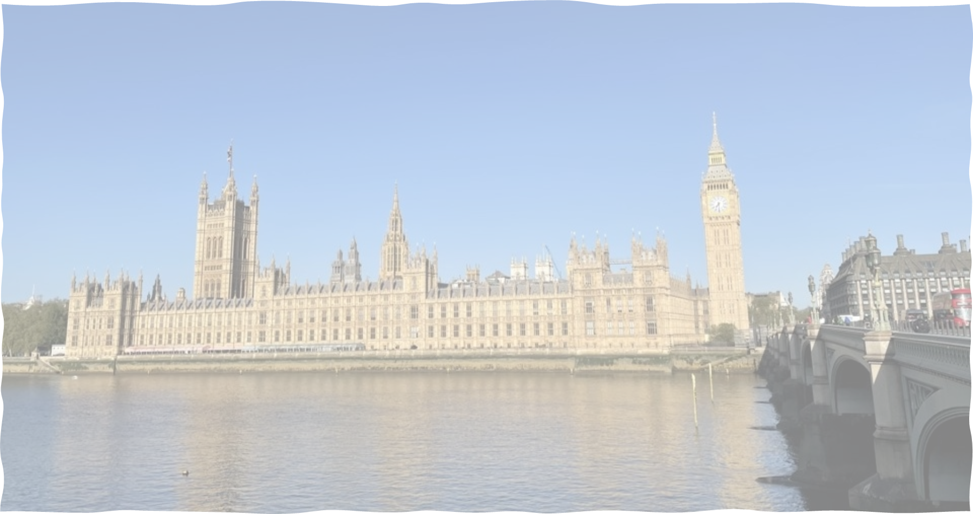
Rachel Jinks
Howard Park Community School
Gold level
UK Parliament
Teacher Ambassador
Accreditation Evidence

Slide 2

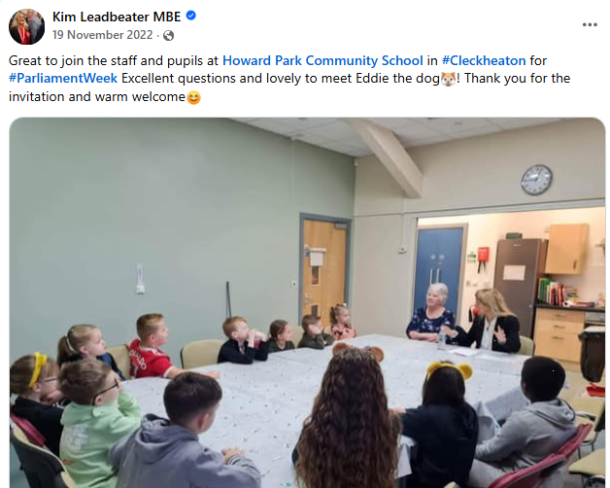
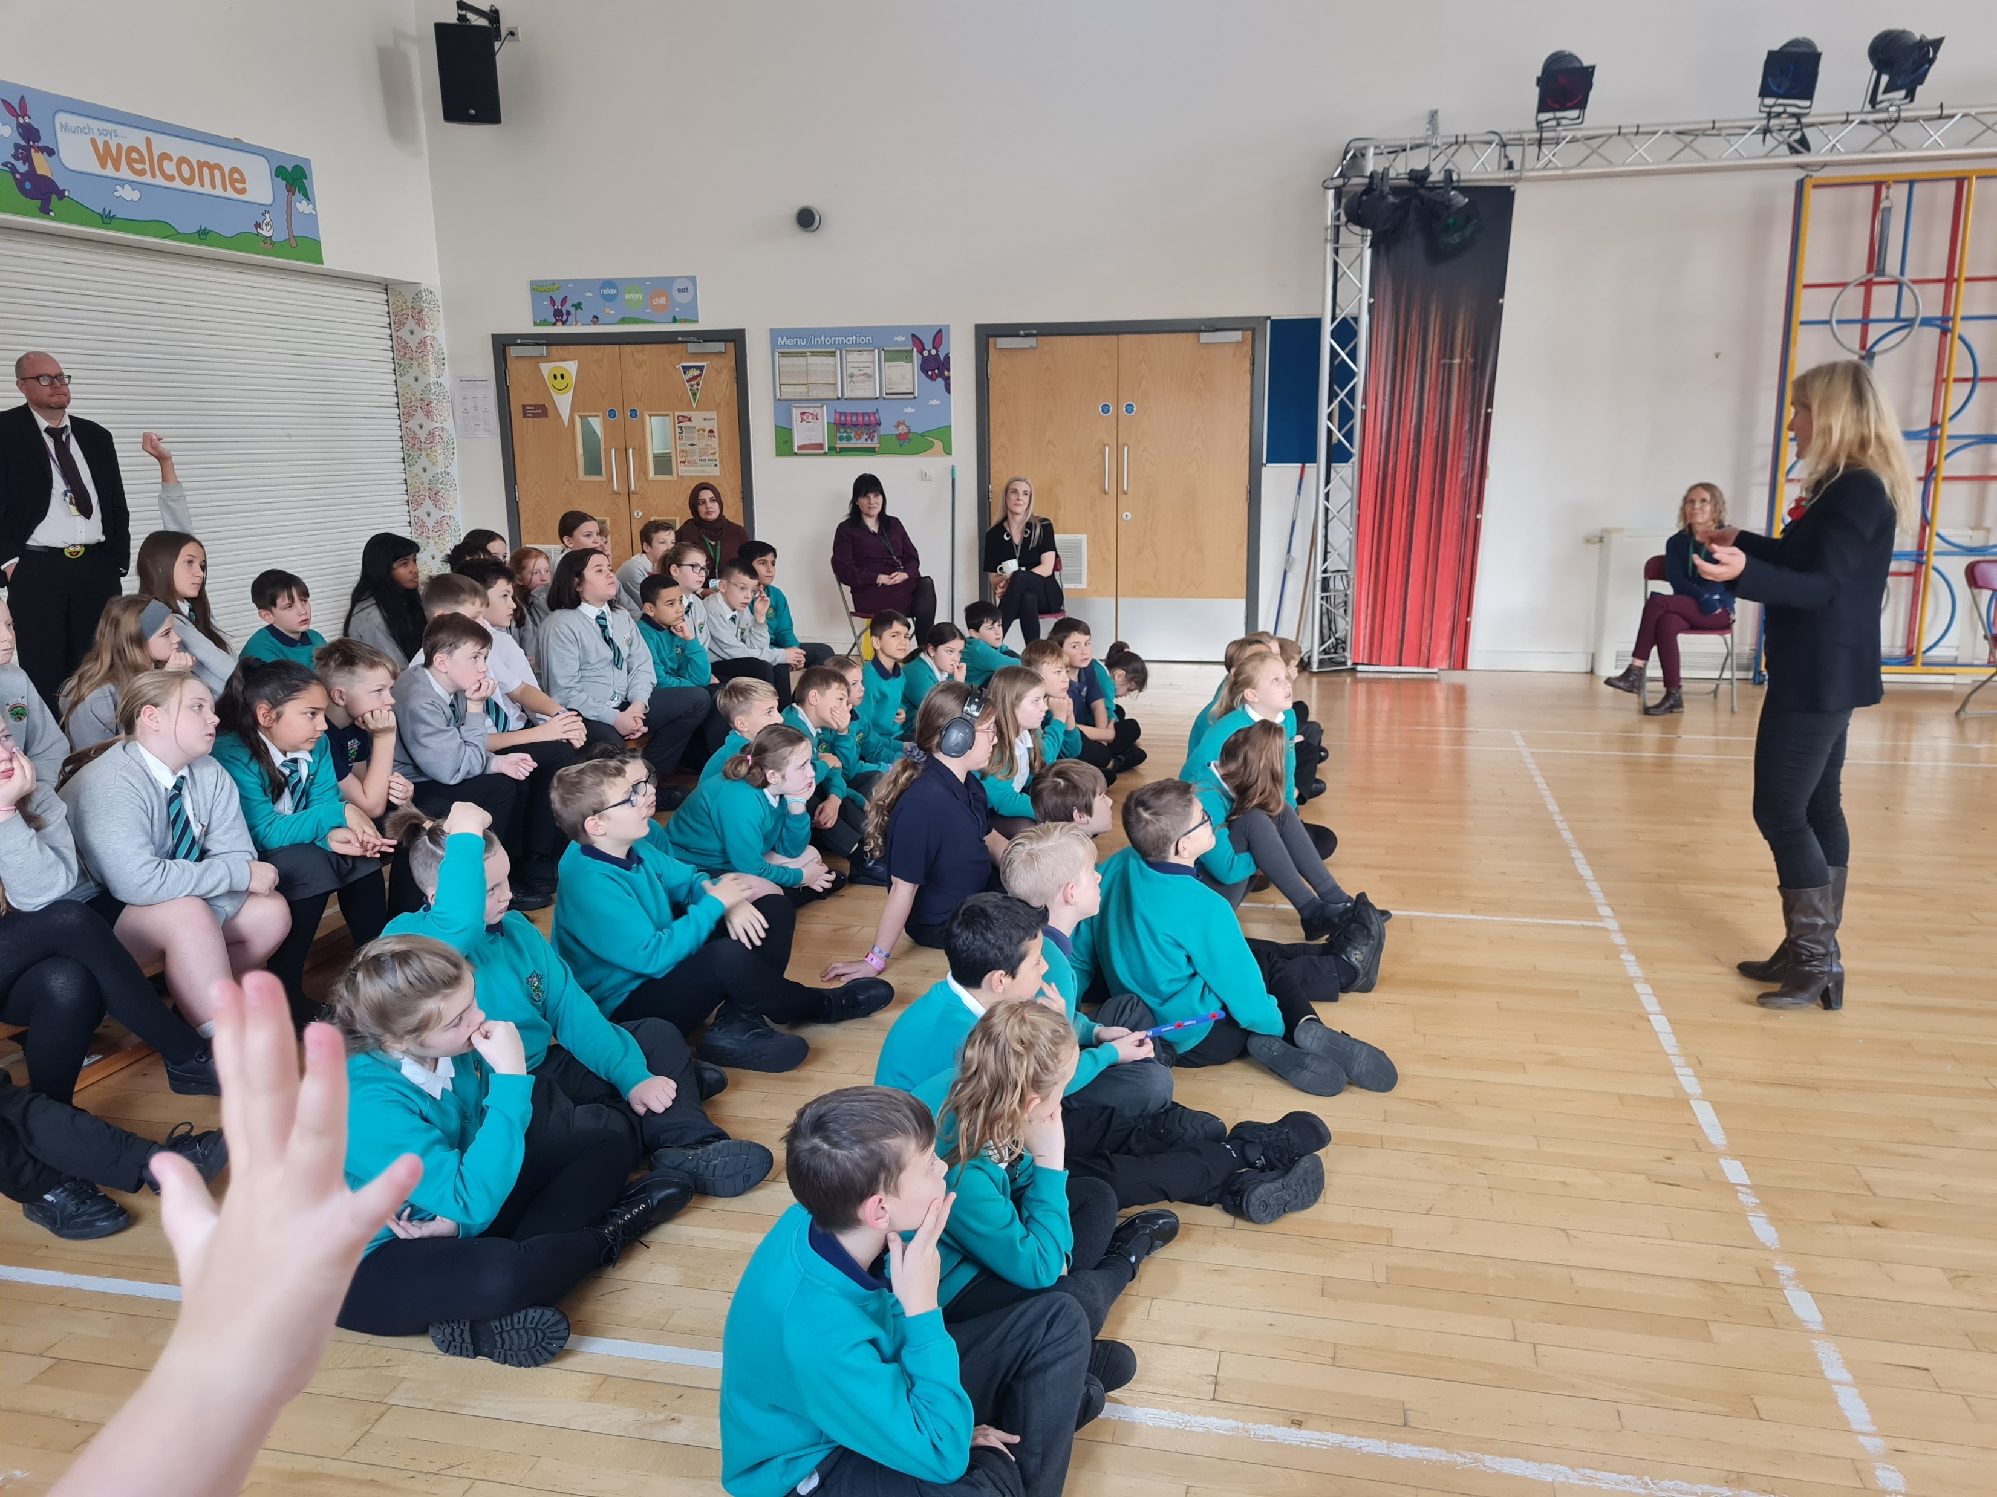
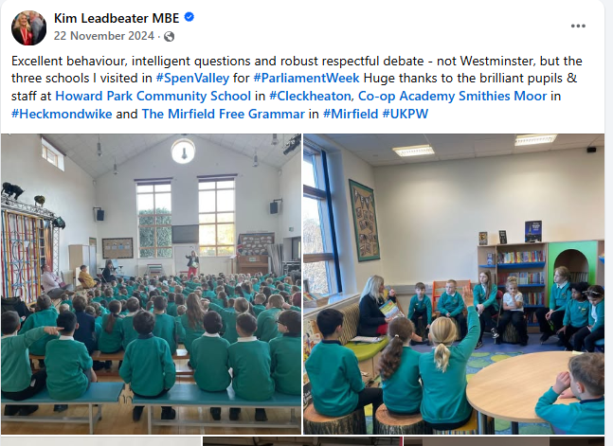
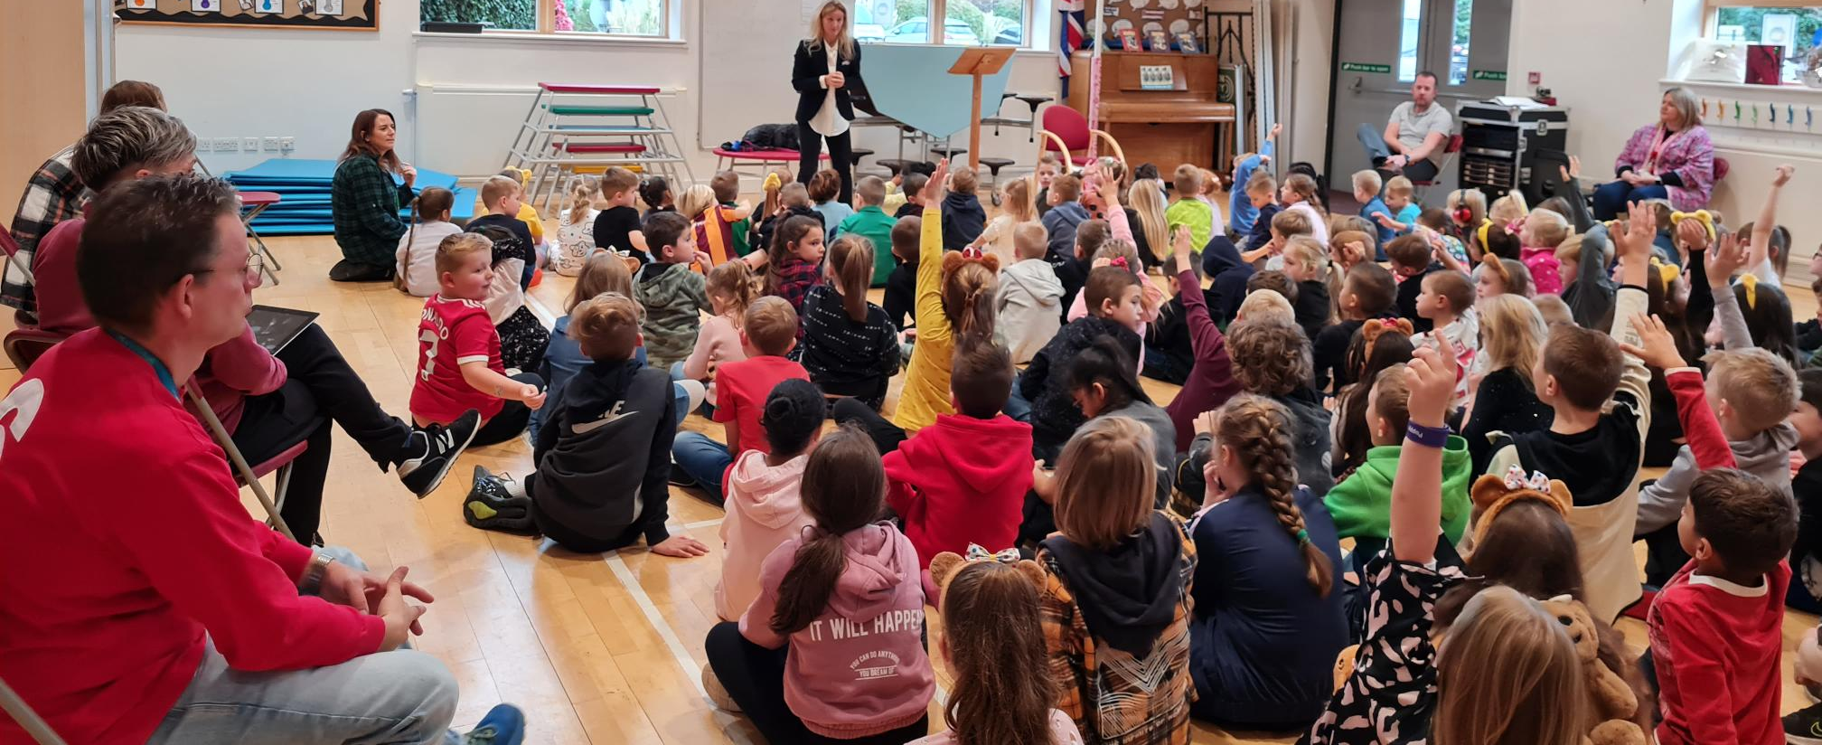
Where we began…
School Council
UK Parliament week
Visits from our MP
Visits to the UK Parliament education centre

Slide 3
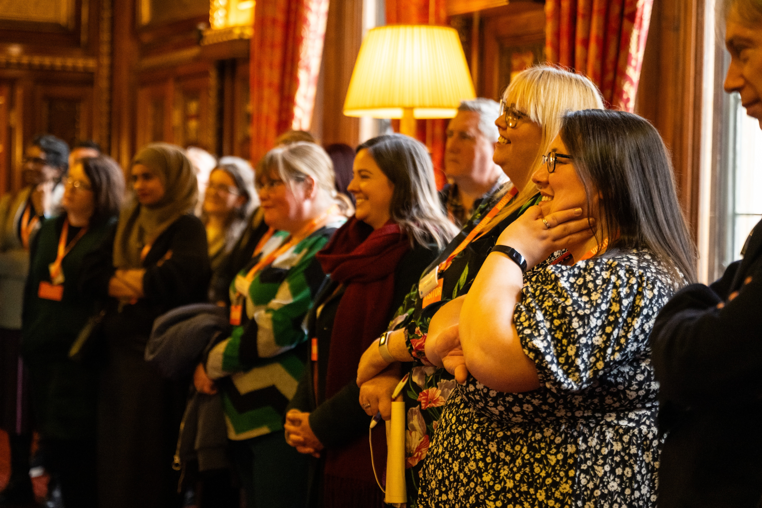
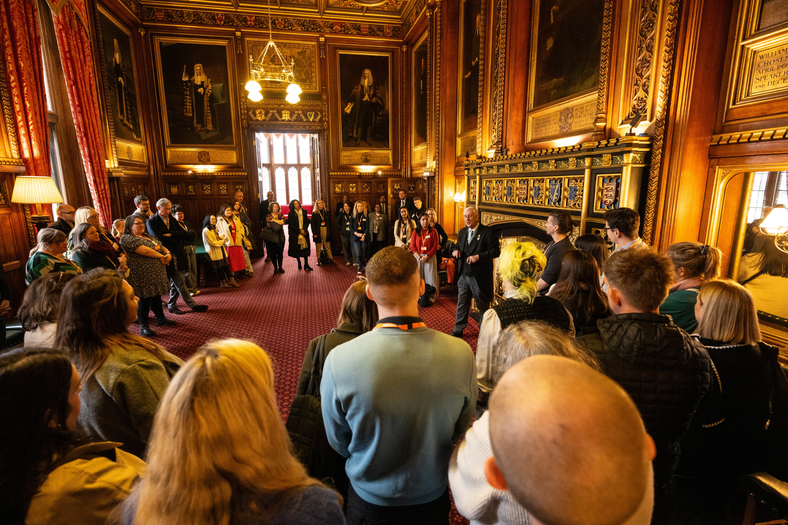
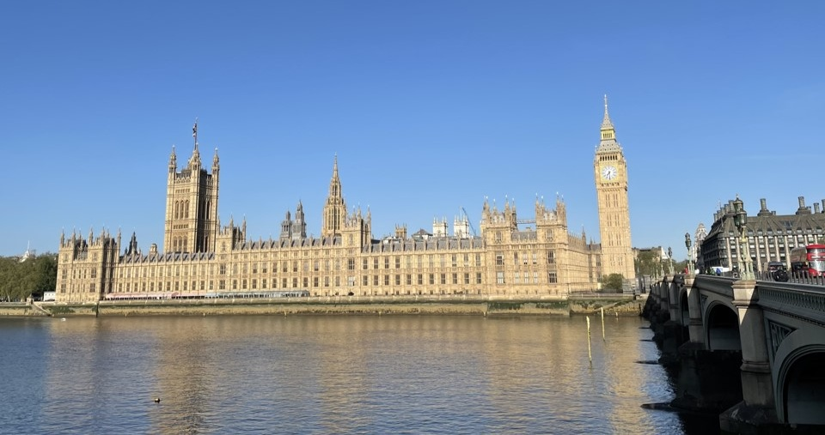
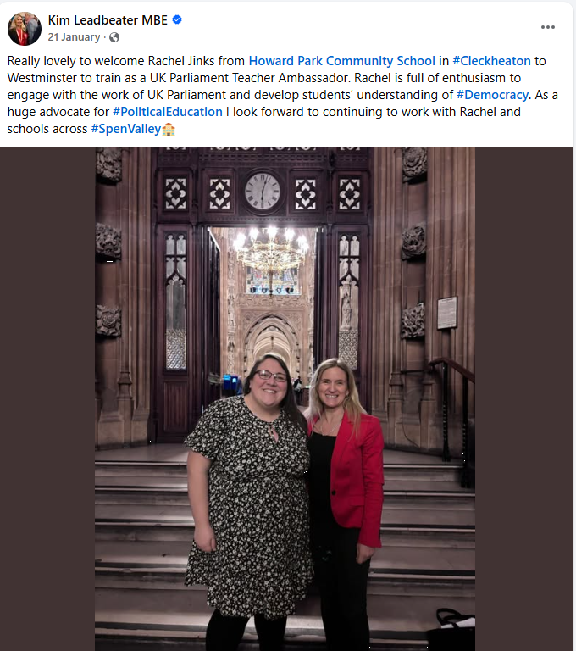
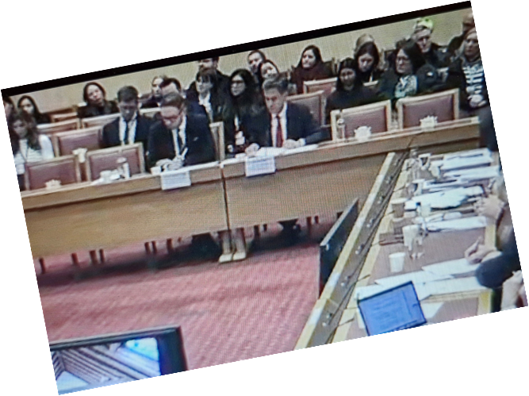
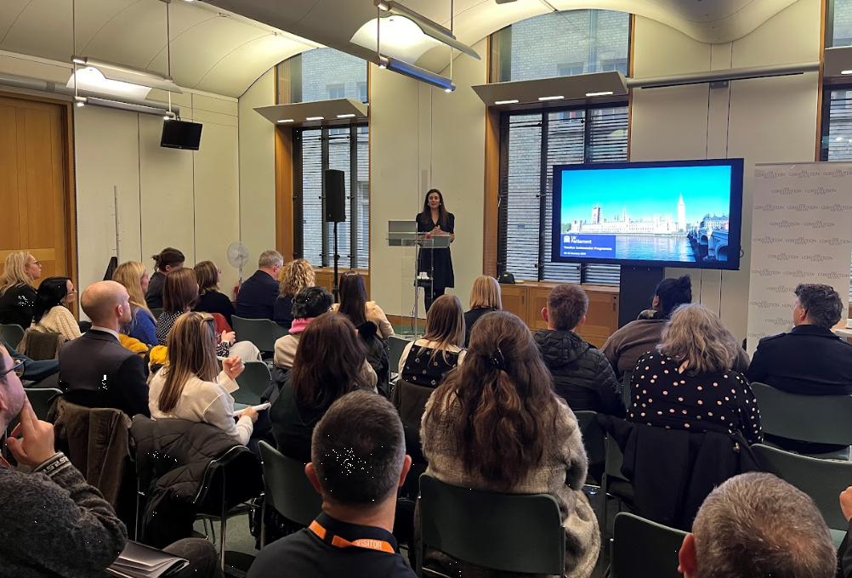
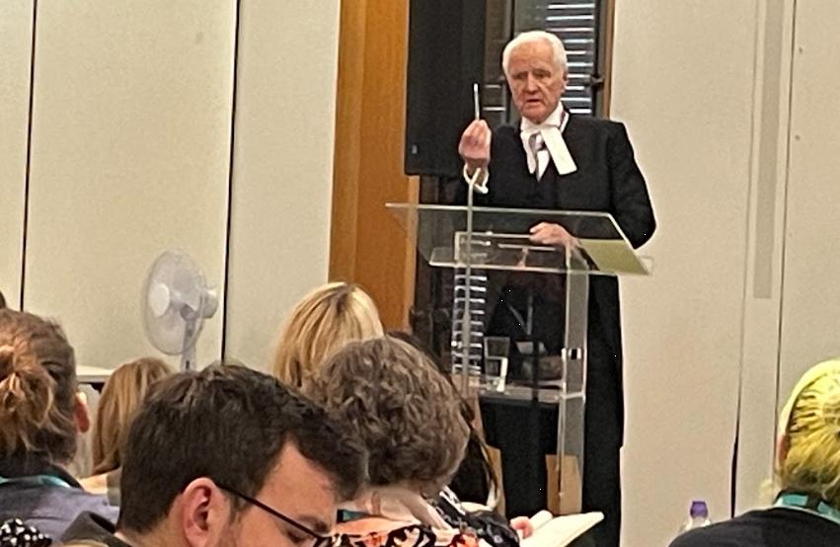
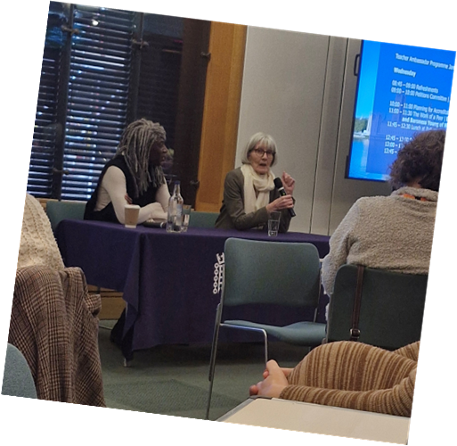
January 2025
Teacher Ambassador Programme

Slide 4
On my return, I met with our Headteacher to put a plan in place for implementing what I had learned.
We agreed on the following priorities:
1. School Parliament: Relaunch our School Council as a School Parliament, closely mirroring the structure of the UK Parliament to expose pupils to correct terminology, deepen their understanding, and increase their impact on the school.
2. Wider pupil involvement: Find ways to involve more pupils in the School Parliament and related events.
3. Curriculum development: Adapt the school curriculum to teach pupils in more depth about the UK Parliament.
4. High-profile events: Continue hosting events linked to UK democracy, such as UK Parliament Week and visits from our MP, and use assemblies more effectively to engage pupils.
5. Collaboration: Work with other schools to share our approach and successes.

Slide 5
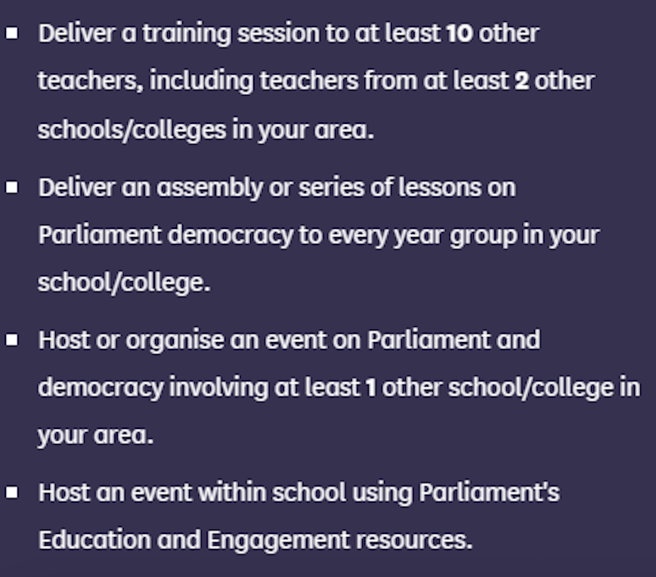

Slide 6
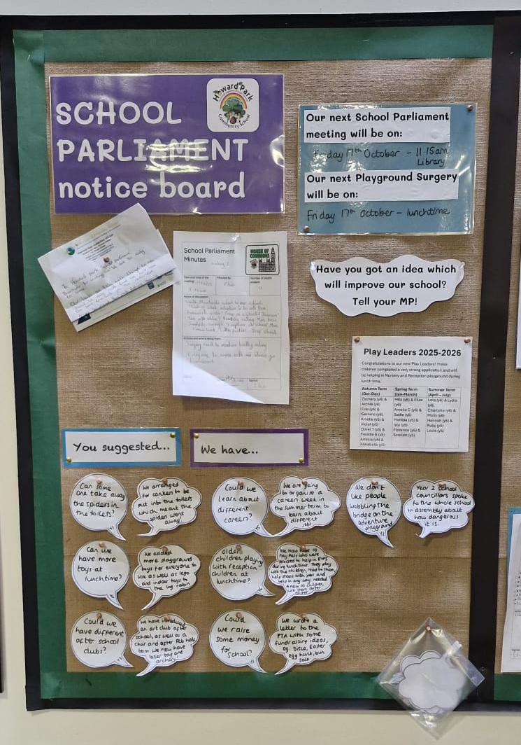
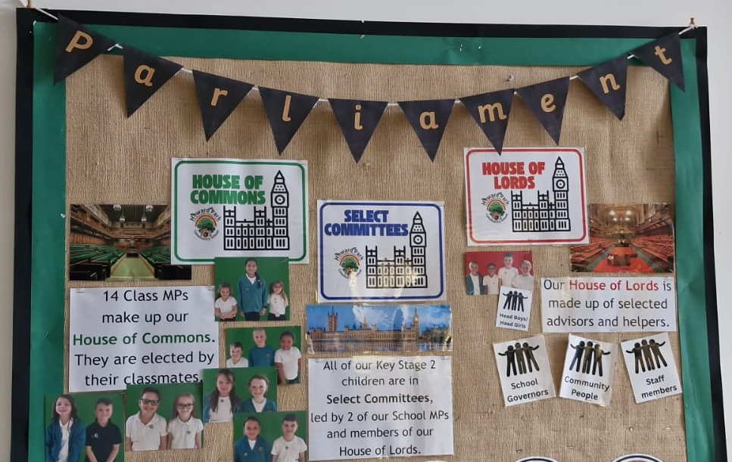


UK Parliament structure
Monarch
House of Commons
House of Lords
Elected
Representative
Selected
Expertise
Petitions
Select Committees
Surgeries
On a topic
Where the work is done!

Slide 7
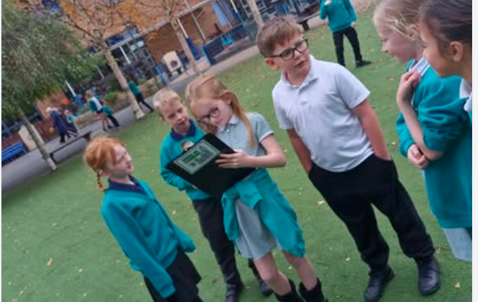

Howard Park School Parliament
Headteacher
School Members of Parliament
School Lords
Petitions (ideas)
Two per class
Elected democratically (hustings and voting)
Attend School Parliament meetings
Run lunchtime surgeries
Head boys/girls – selected by staff
Staff / Governors
Act as advisors
Playground Surgeries
Select Committees
All KS2 children part of one
– choice based on their interest and skills
Chaired by two/three KS2 MPs or Lords
Supported by a Lord (staff)

Slide 8
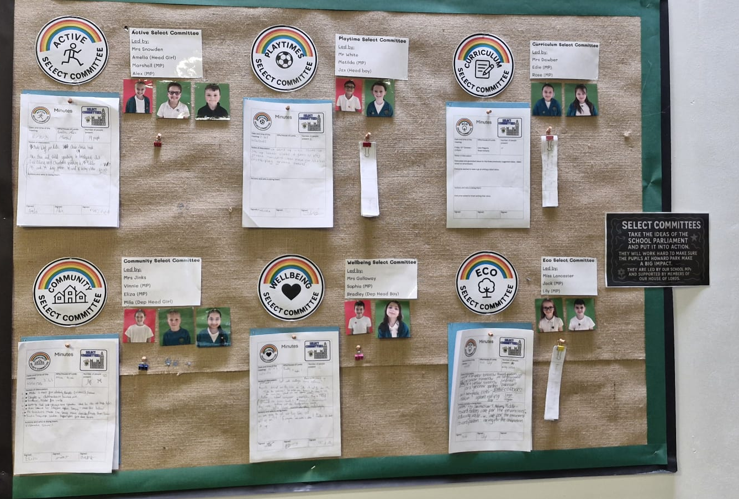

Slide 9
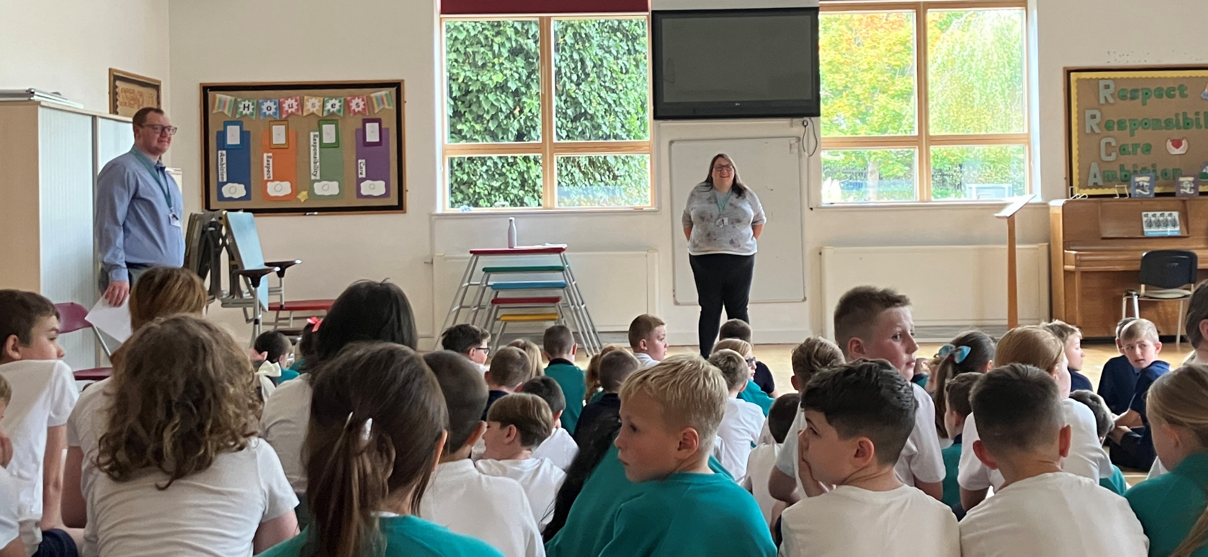
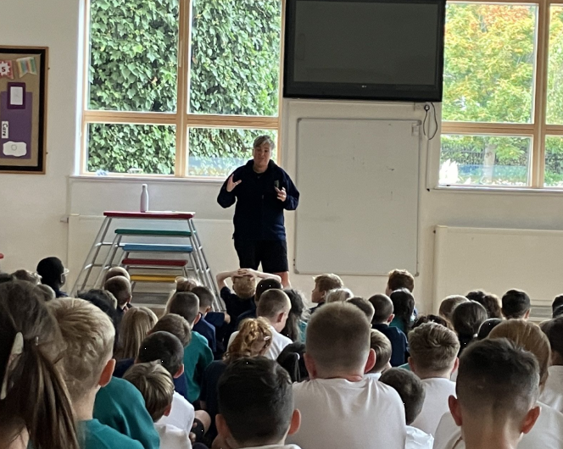
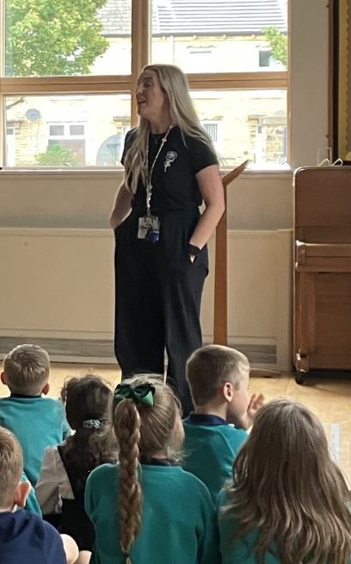
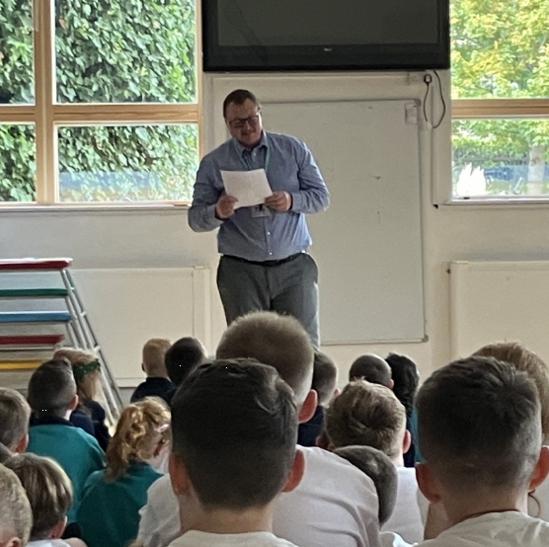
Select Committees
We have put a weekly 25 minute session into our KS2 timetable for the Select Committees to meet.
6 staff run a Select Committee each, but they are chaired and led by 2 or 3 of our MPs or House of Lords (Head boys/girls).
Each Select Committee was pitched to the children and they chose which Select Committee they would like to join and commit to for the academic year.
Every 4th week we have an assembly in this slot, where the chairs of the committees feed back to the whole school about the progress of their select committee.
The MPs/Lords take responsibility for taking minutes and ensuring actions are completed.

Slide 10
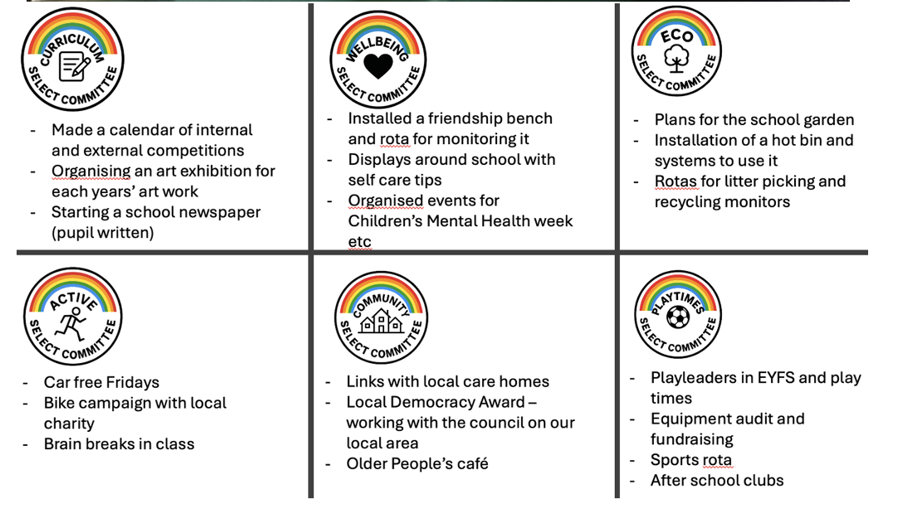

Slide 11
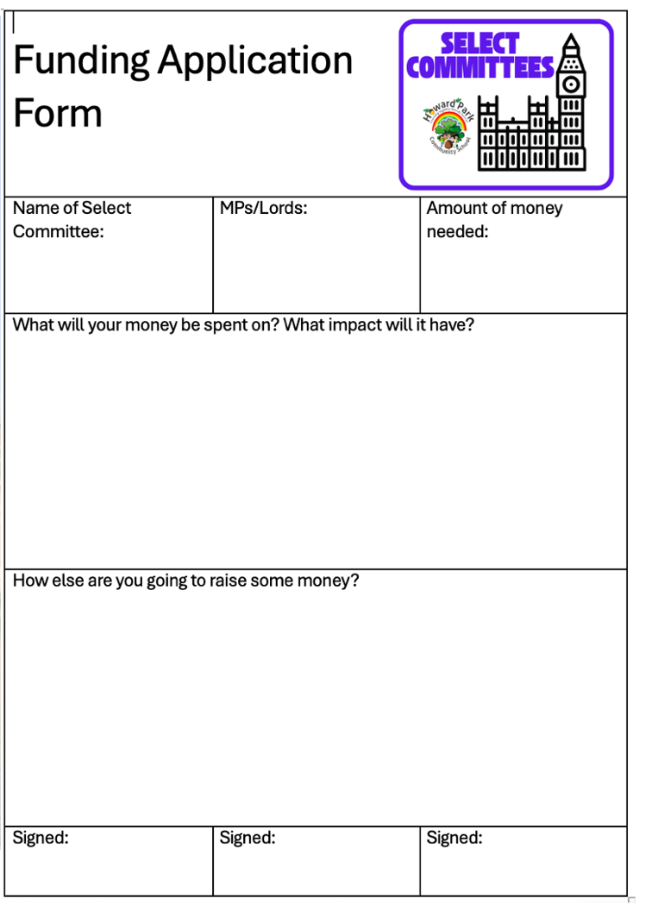
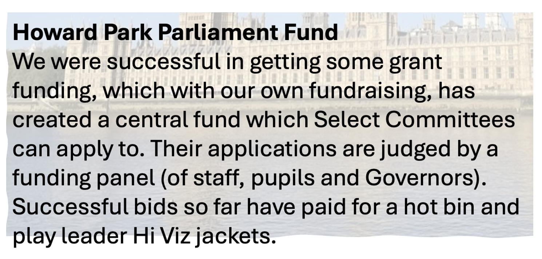

Slide 12
Wider Pupil Involvement
One of the key things I wanted to do with our new School Parliament was involve a larger number of pupils.
By involving all of our Key Stage 2 children (120 children) in the Select Committees, we have seen them taking a much greater responsibilities for the remit of their ‘team’.
We also changed our Houses of Parliament day trip for School Councillors to be a whole class year 5 residential to London including the Education Centre tour.
This means going forward every child will have the chance to visit and see democracy in action!
Notes:
Trip to london

Slide 13
Curriculum Development
UK Democracy/Parliament lessons to our Personal Development (PSHE) curriculum from Years 1-6.
Resources on the UK Parliament website were demonstrated to all staff in school, encouraging them to upskill their knowledge
Regular assemblies are held covering different aspects of UK Parliament, as well as wider topics linked, for example the Suffragettes, Local Democracy day.
7 week topic to our History Curriculum, taught in Year 5. This has now been delivered to 2 year groups and will continue in future years. The main objectives of this unit are:
    The Magna Carta and early Parliament
    Key changes in representation and law making between 1215 and 1900
    The role of the Suffragettes in equal voting
    Changes in the structure of Parliament since WW2 including devolution
    Their ideas for how Parliament may change in the future.
Notes:
PD lessons
Year 5 History lessons
Assemblies

Slide 14
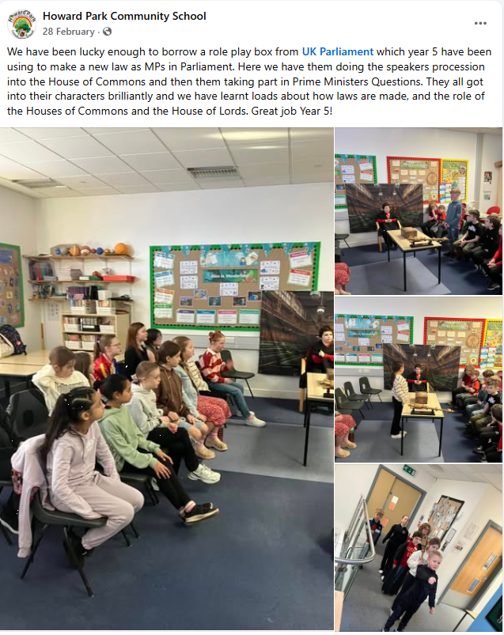
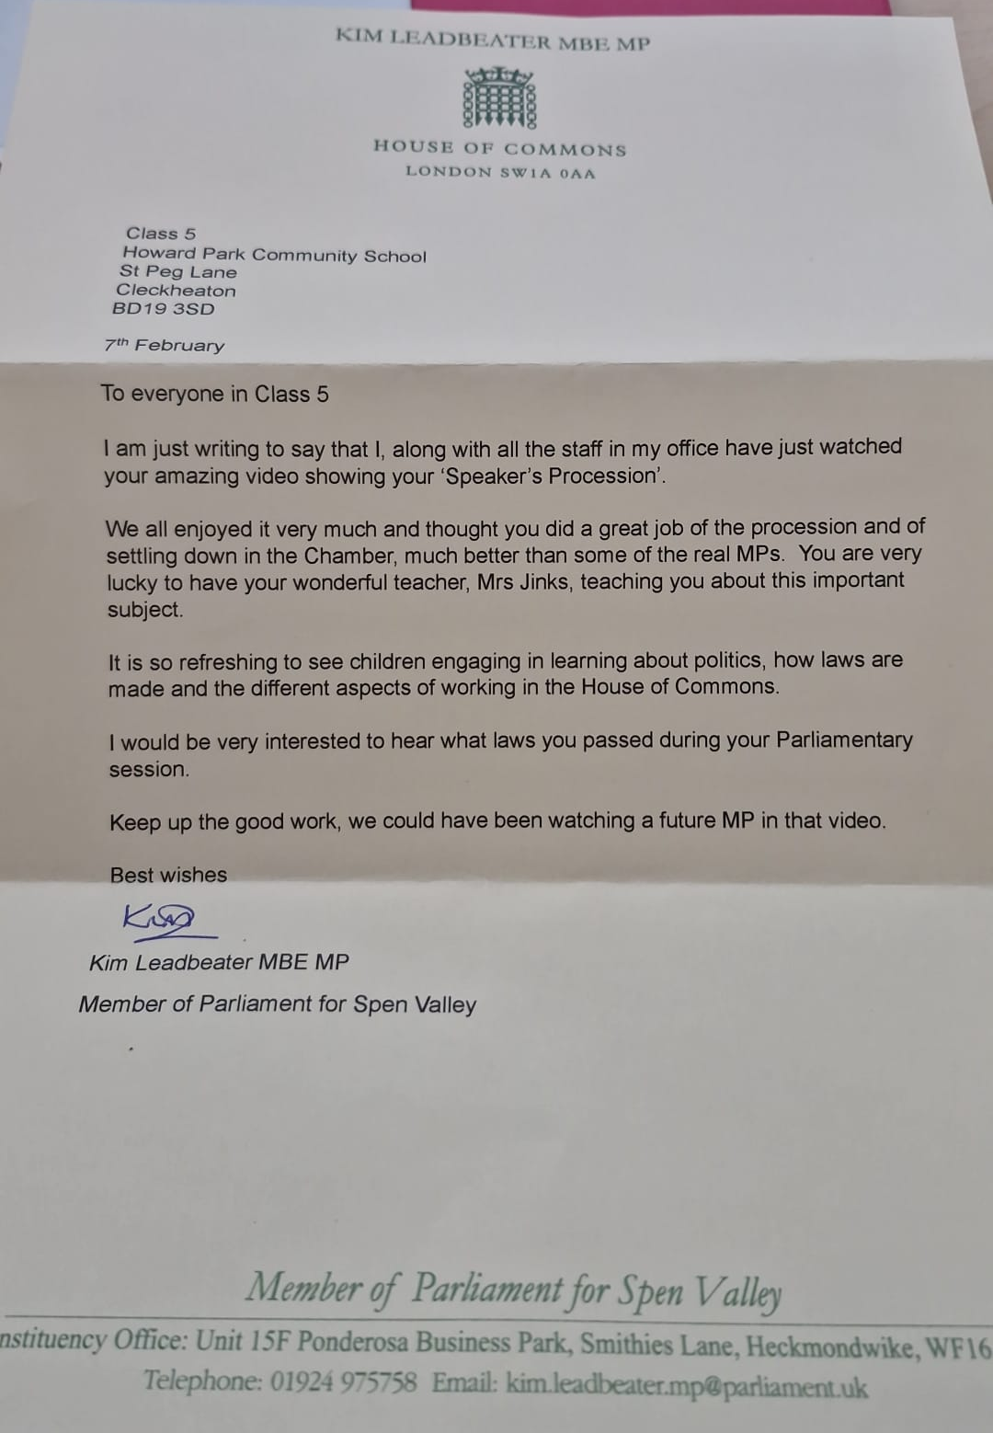
Events
Loan Box – Spring 2025 and Autum 2025
Notes:
Loan box –Year 5 and 6 – teachers
Parliament week
MP visit
Lords visit
Other opportunities – litter pick, letters, etc

Slide 15
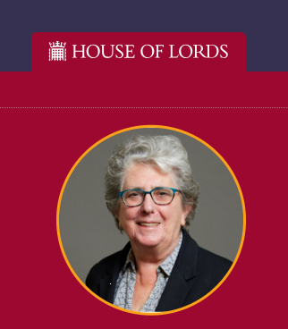
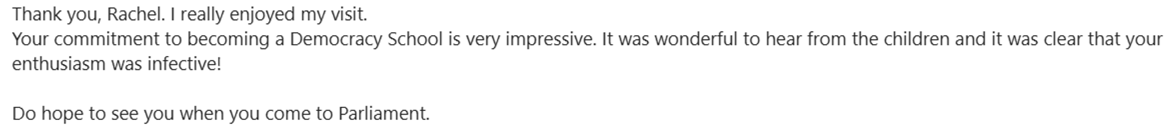
Events
We are lucky to have a member of the House of Lords, Baroness Pinnock, live locally to our school.
We invited her to come and visit us in April and tell us about The House of Lords. She brought with her her Great Seal of the Realm and the letter she received when she became a Peer.
Notes:
Staff meeting
Link with moorlands
Network Meeting

Slide 16
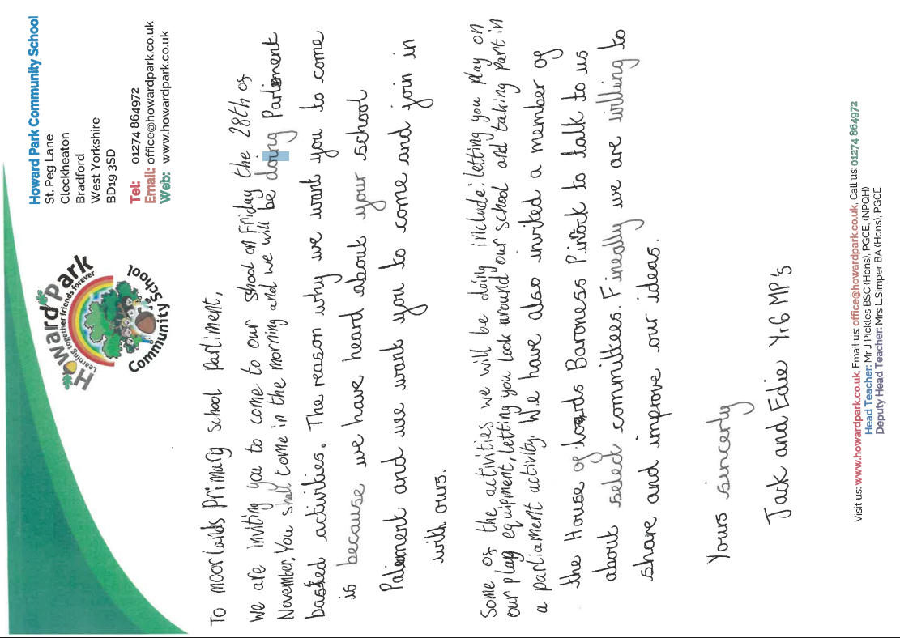
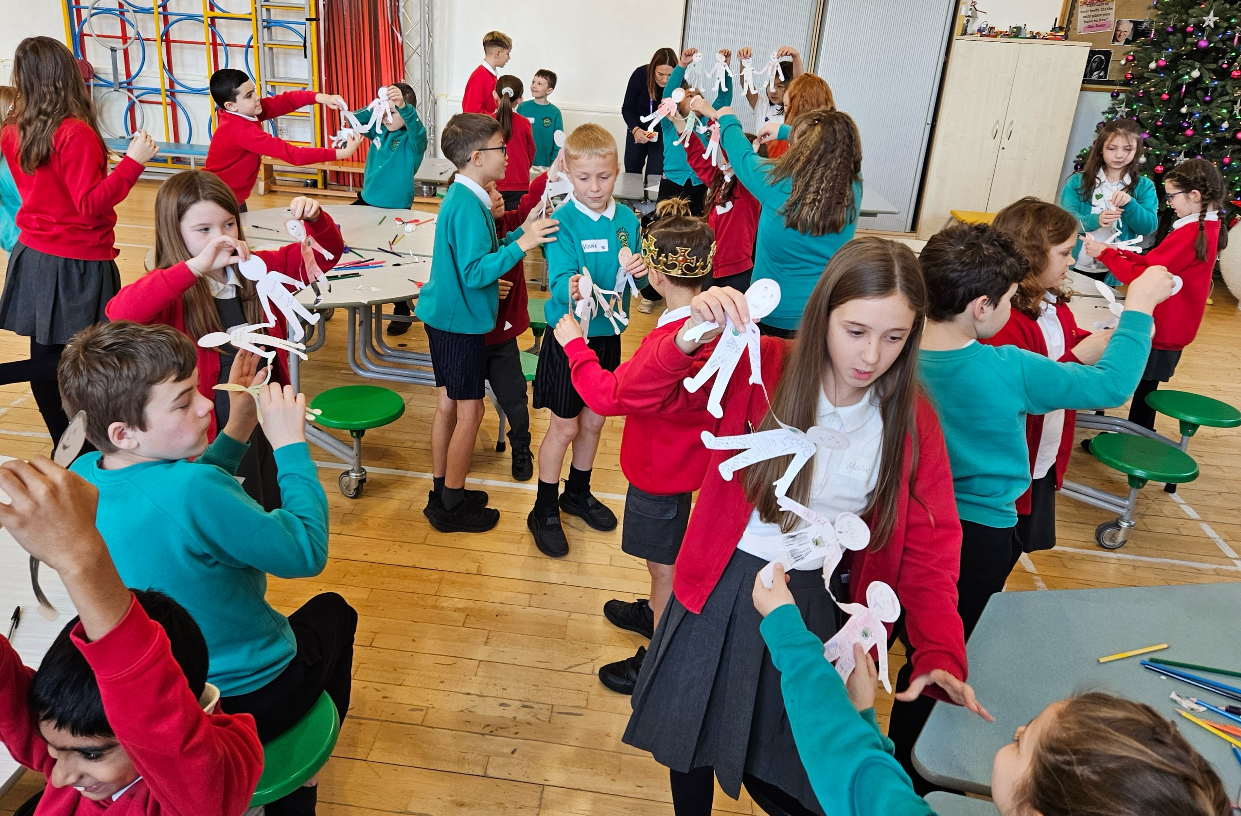
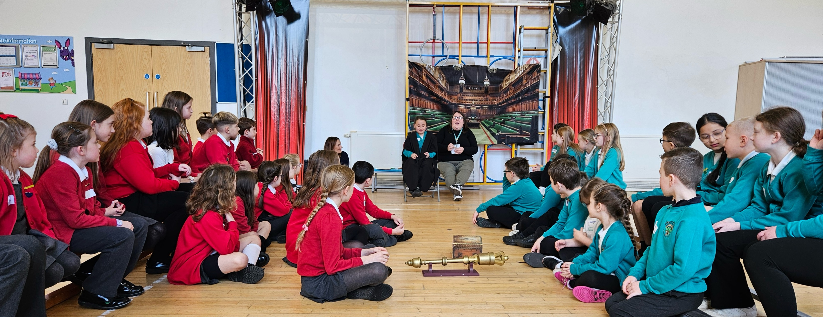
Collaboration
Staff meeting
Personal Development Network
Offer to other local schools
    Lesson observation by local teacher, who passed on to 3 teachers in her school
Linking project
Notes:
Staff meeting
Link with moorlands
Network Meeting

